Slide 1

Aerospike
Type: Key-value store
URL: https://www.aerospike.com/
Organization: Aerospike, Inc.
Team Members: Jason Reader, Ling Xiang

Slide 2

History
Created as Citrusleaf 2.0 in 2010
Rebranded into Aerospike in August, 2012
Acquired AlchemyDB in 2012 to integrate the two databases functions
Open-sourced on June 24, 2014
Currently on version 4.2.0.4 which was released on June 25, 2018
https://en.wikipedia.org/wiki/Aerospike_(company)

Slide 3

Intended Usage
Designed for large internet applications such as Twitter, Pinterest, etc.
Cache replacement is made easy with Aerospike’s high throughput and low latency, especially if data is dynamically changing.
User profile storage usually used by advertising or marketing companies.
Recommendation engine uses Aerospike’s high throughput of data to keep up with user behavior.
https://www.aerospike.com/solutions/technology/use-cases/

Slide 4

Feature
Key-value Store(KVS) operations associate keys with a set of named values.
Policy containers—namespaces (RDBMS databases): control the retention and reliability requirements for a set of data.
Namespaces: Sets (RDBMS tables) and Records (RDBMS rows)
Records contain a unique indexed key, and one or more bins (RDBMS columns) that contain the record values.
https://www.aerospike.com/docs/guide/

Slide 5
Feature cont.
Meta-Data info:
Generation: 16 bit field, changed on each record update
Time-To-Live: 32 bit field, expiration time
User-Defined-Functions
Large Data Types(LDTs)
https://www.aerospike.com/docs/guide/

Slide 6
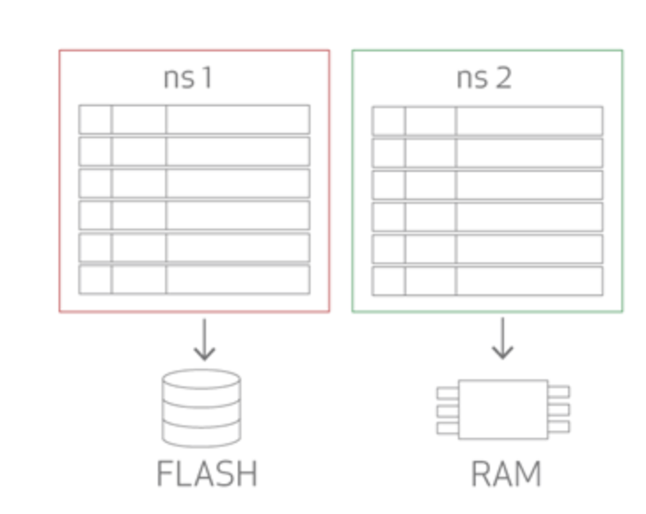
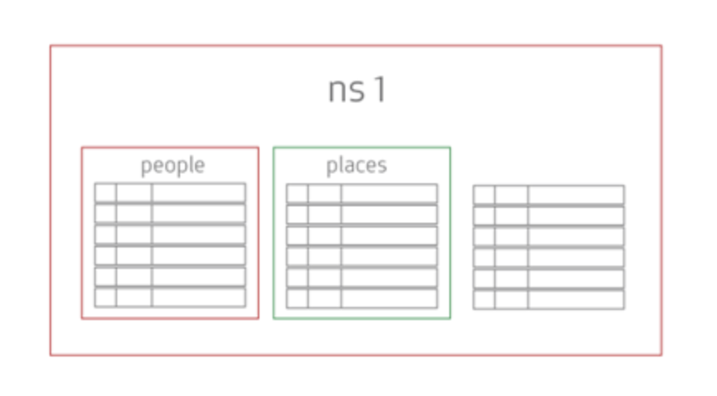
Data Model
Namespaces: A part of a database or group of databases that contains records and indexes that binds data to a storage device.
Sets: Within namespaces the records belong to sets that help logically group records into collections
Records: The base unit of storage in the database, represent the rows within the system and are accessed through key-value pairs
Bins: Within a record, data is stored in one or many bins.
https://www.aerospike.com/docs/architecture/data-model.html

Slide 7
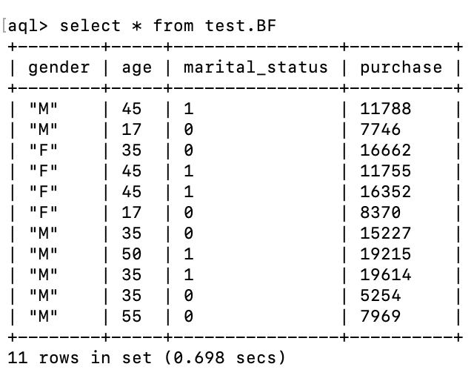
Document Example
Namespace: test
Set: BF
Bins:
gender
age
marital_status
purchase

Slide 8
Create a database and Insert a Document
Inserting data into default namespace (test) with BF set.
Creating bins:
create index gender on test.BF (gender) String
create index age on test.BF (age) Numeric
create index marital_Status on test.BF (marital_status) Numeric
create index purchase on test.BF (purchase) Numeric

Slide 9

Querying Documents
SELECT gender FROM test.BF
SELECT * FROM test.BF WHERE marital_status = 1
SELECT * FROM test.BF WHERE purchase between 10000 and 20000
SELECT * FROM test.BF WHERE PK = 1

Slide 10

Updating Database
Inserting data into test.BF
insert into test.BF (PK, gender, age, marital_status, purchase) values (1, 'F', 17, 0, 8370)
insert into test.BF (PK, gender, age, marital_status, purchase) values (2, 'M', 55, 0, 7969)
insert into test.BF (PK, gender, age, marital_status, purchase) values (3, 'M', 35, 0, 15227)
insert into test.BF (PK, gender, age, marital_status, purchase) values (4, 'M', 50, 1, 19215)
insert into test.BF (PK, gender, age, marital_status, purchase) values (5, 'M', 35, 0, 5254)
insert into test.BF (PK, gender, age, marital_status, purchase) values (6, 'F', 45, 1, 11755)
insert into test.BF (PK, gender, age, marital_status, purchase) values (7, 'M', 45, 1, 11788)
insert into test.BF (PK, gender, age, marital_status, purchase) values (8, 'M', 35, 1, 19614)
insert into test.BF (PK, gender, age, marital_status, purchase) values (9, 'F', 35, 0, 16662)
insert into test.BF (PK, gender, age, marital_status, purchase) values (10, 'F', 45, 1, 16352)
insert into test.Bf (PK, gender, age, marital_status, purchase) values (11, 'F', 17, 0, 19172)
insert into test.BF (PK, gender, age, marital_status, purchase) values (12, 'M', 17, 0, 7746)

Slide 11
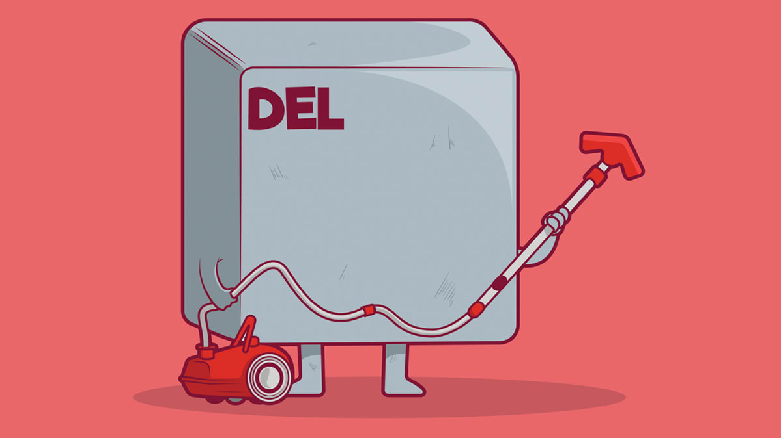
Delete a Document
DROP INDEX <ns> <index>
Drops the designated index from the namespace

Slide 12

Example Data Source Used
Source: https://www.kaggle.com/mehdidag/black-friday/version/1
Black Friday data set
A study of sales through consumer behaviors
Contents: User_ID, Gender, Age, Marital_Status, Purchase
Size: 550,000 documents (Manually Inputted 12 documents)

Slide 13

Things to Keep in Mind
Aerospike by default stores only the hash of the setname+key concatenation, called the DIGEST, which is what the Aerospike Client sends to Aerospike.
Aggregation through Aerospike is much more complex and requires UDF files or a creation of an aggregation module through various terminal commands.

Slide 14
Challenges and Issues
Could not create our own namespaces, so we used the default test namespace.
Trouble creating bins and naming the bins properly
Learning curve for understanding the new data model was bigger than we thought
Could not find a proper GUI, so we had to do all our work through the terminal

